Slide 1
Practical and meta- challenges in modeling database migrations: case study of the University of Michigan MatThaei Botanical Gardens and Nichols Arboretum
Andrea K. Thomer*, Samual Sciolla, Alexandria Rayburn, Maryse Lundering-Timpano
School of Information, University of Michigan
*athomer@umich.edu, @an_dre_a_
June 6, 2019
JCDL – SIG-CM Workshop – Champaign, IL

Slide 2
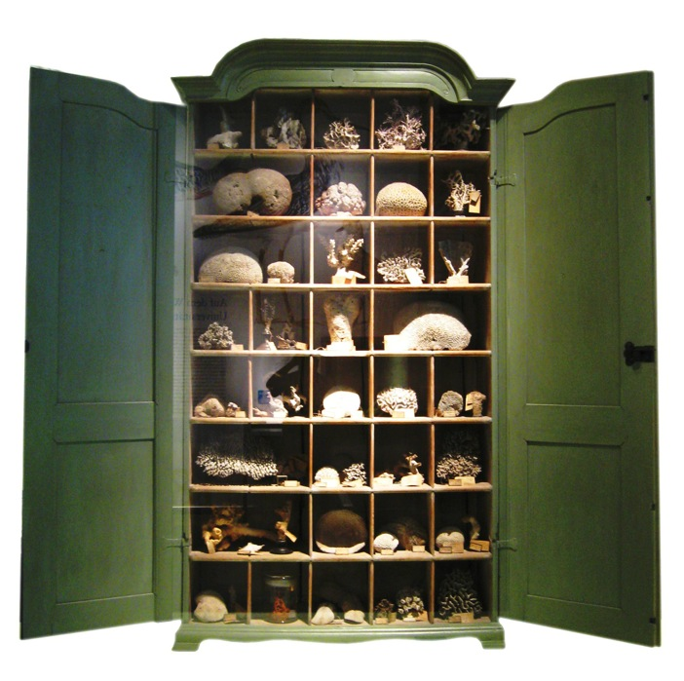
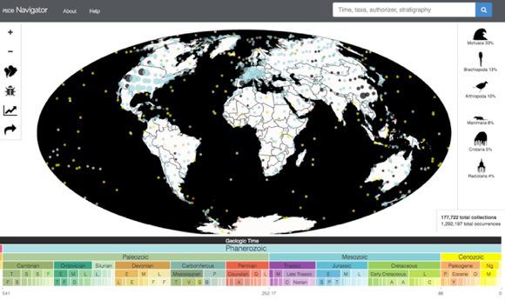
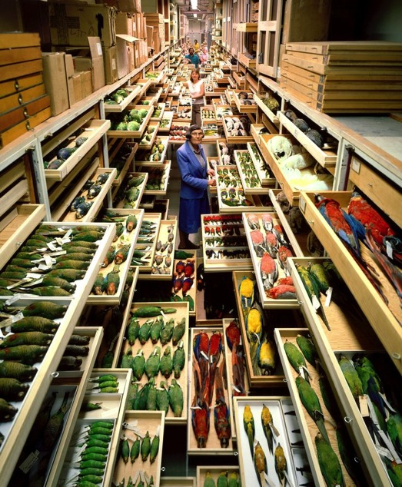
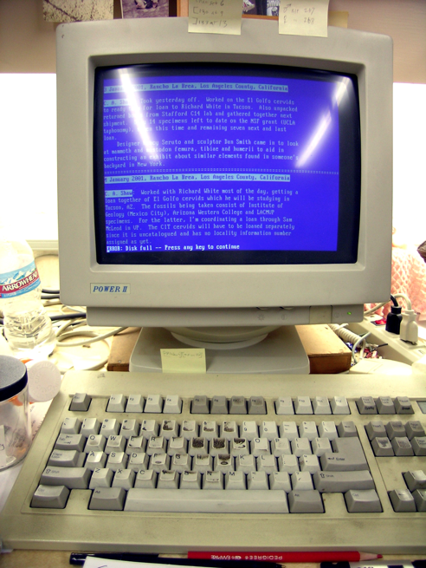

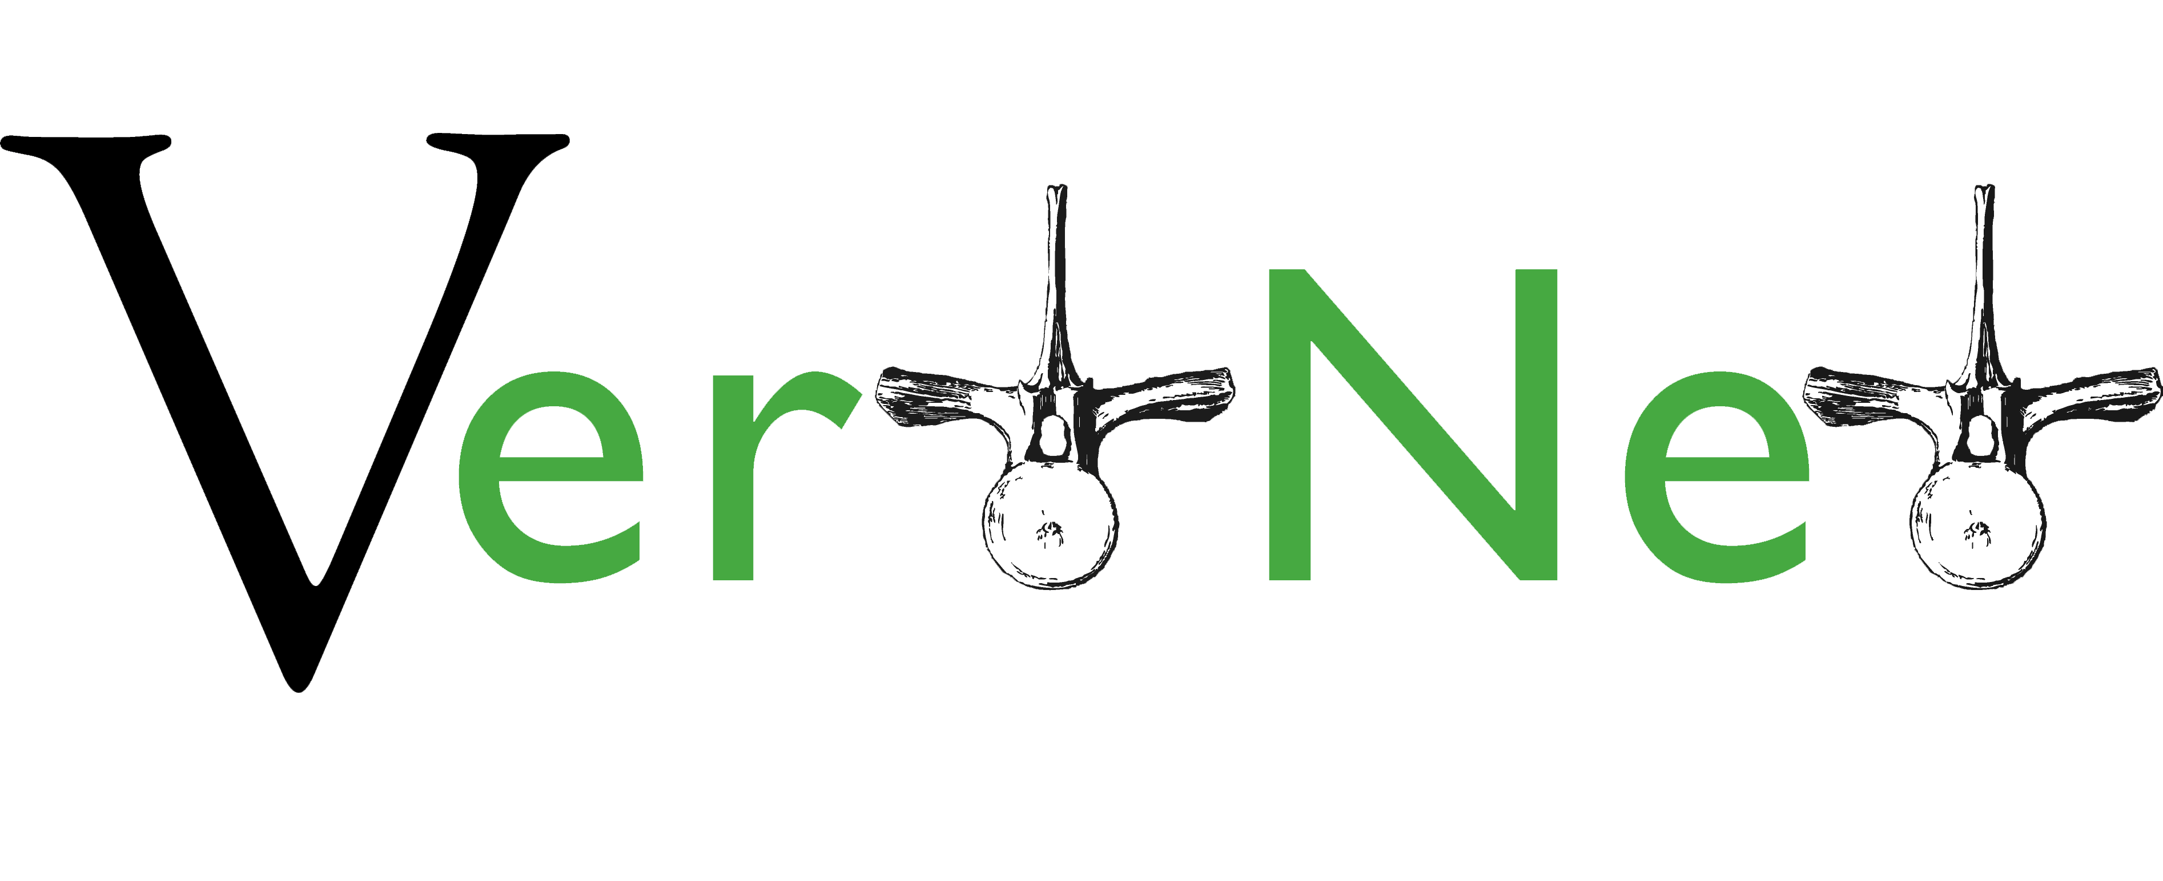
Change over time: Not just in the natural world
Notes:
Make sure to emphasize – much of the data behind all these trees and timelines is rooted in specimen and "physical sample" collections
Here's the thing – the infrastructure used to manage, make, and store the data and scholarship of deep time is changing as well.
The infrastructure of deep time might be thought of the various specimens used to justify research; the scholarship that's produced – the memory institutions that manage those specimens and scholarship – and since about the 1970s, the computer systems that store digital data.

Slide 3
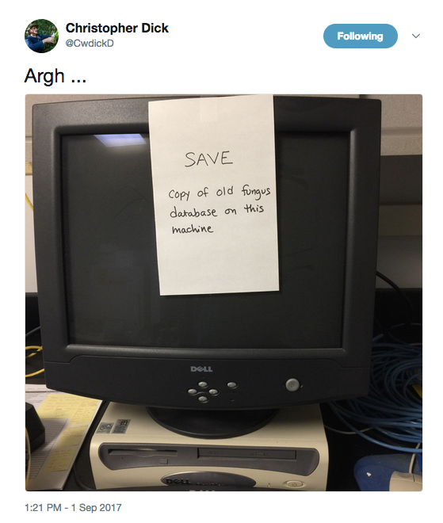
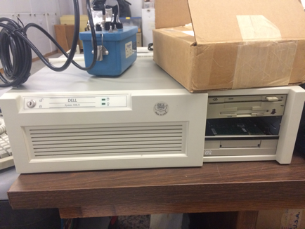
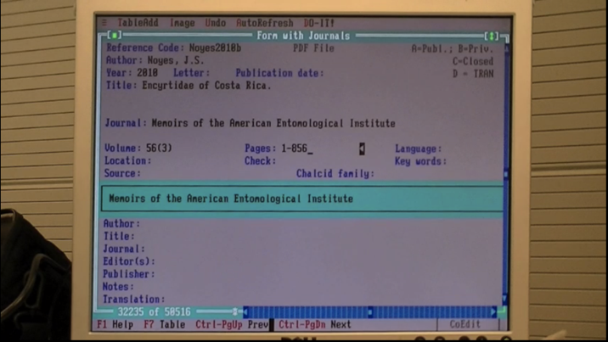
Change over time?
2015
2008
2017
2016
Notes:
Tension between a need to update – either because of forced obselesence or changing paradigms/user needs
And a strong desire to NOT. Because migration is a pain.
CMs generally don't have time to do it – often don't have the training -

Slide 4
(Data) Infrastructure doesn't change gracefully
Change = instability! So of course we don't want infrastructural change!
When infrastructure DOES change, it's hard, and takes "time and negotiation, and adjustment" (Star and Ruhleder, 1996)
Databases are built to support relatively narrow change -- adding new new records, editing individual records, small schema edits.
But they don't do well with:
Changes in hardware
Changes in the entire information structure of a data collection (see work by Buneman, Jagadish)
Changes to the information organization paradigm.
"… and yet it moves"
Notes:
Moves in response to forced obselesence in our hardware/software
In response to true innovation in our data sharing platforms (e.g. idigbio, gbif)
And in response to changing user needs and priorities

Slide 5

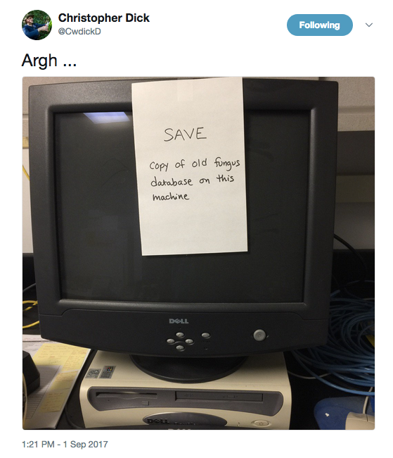
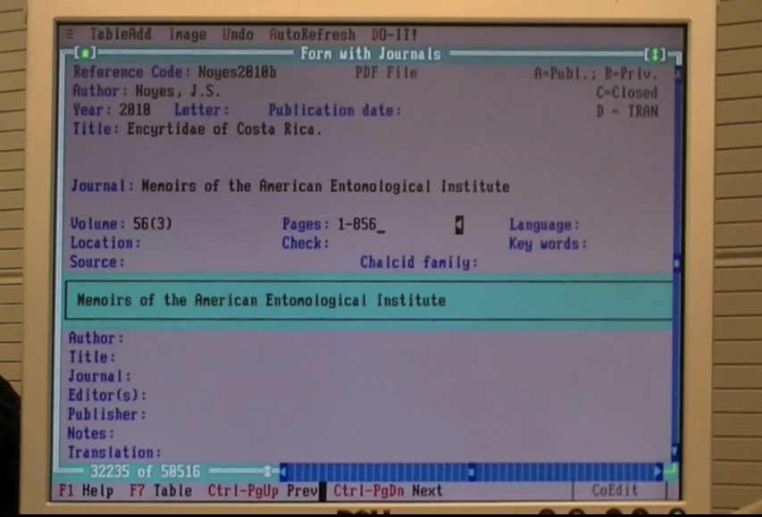
Coping with – and modeling – CHange

Slide 6
Migrating Research Data Collections (IMLS Grant #RE-07-18-0118-18)
Goal: To better understand the method and motivating factors underlying research data collection migration – and thereby, better support this work.
Starting with NHMs, then moving on to non-NHM LAMs
Premise: the strategies that information professionals (including you!) use to keep data systems running (whether through migration, adaptation, or something else) should serve as the basis for software development and best practices in database migration
Method: Multi-site case studies of NHM data and database migration.

Slide 7
Cases to date
16 collections, 32 collections staff, ~54 databases
Qualitative methods – interviews, review of documentation and data structure
Interviews ask about past, current, and anticipated future state of databases
Conduct follow up interviews when possible, ~1 year later.
Based in pilot work from 2014 (finally published in 2018)
Names generally changed to protect the innocent
Interview transcripts, documentation, and databases (when available) examined to create case reports to map migrations and document database histories
Working on developing ways of effectively communicating these histories

Slide 8
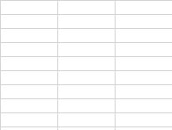
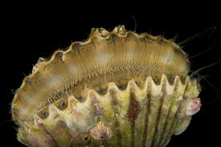
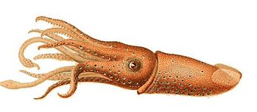
Pilot work: Mapping migrations in NHMs
Case: Invertebrate Zoology Collections at "Mountain University"
Past
At interview
Current
Originally paper catalogs
Digitized to Filemaker Pro
Stored in Excel
Mollusk Collections
Successfully managed in Arctos
Digitized to Filemaker Pro
Stored in Excel
Originally paper catalogs
Non-mollusk Invertebrate Collections
(For more, see Thomer et al., 2018)
Notes:
In 2014 I started conducting interviews with collections managers to try to refute of validate my anecdotal and personal evidence of weird patterns in NHM infrastructural change – I found that the infrastructure of deep time has indeed been shifting and evolving – but in some ways that I found surprising
- Largely – moves took years rather than months – and often required a lot of creativity and reliance on less-than-ideal data management systems.

Slide 9
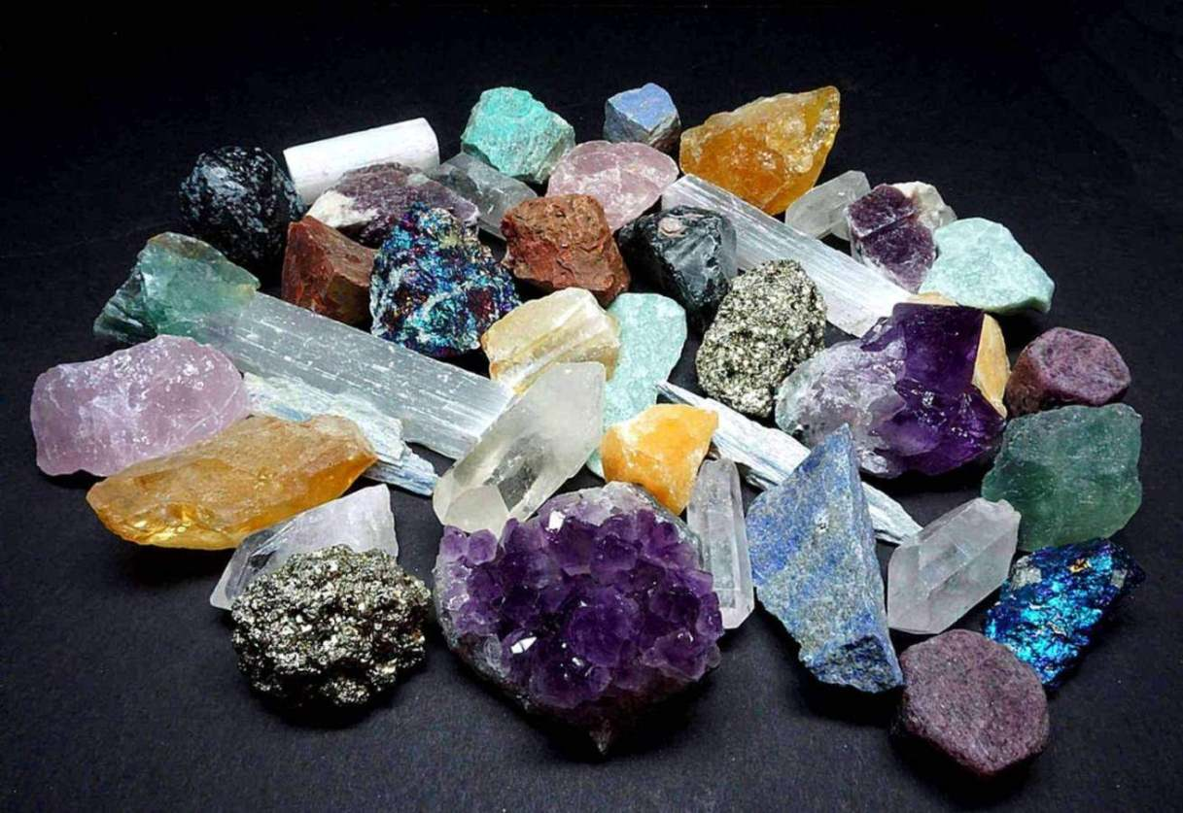
Pilot work: Mapping migrations in NHMs
Case: Mineralogy Collections at "Prairie University"
Past
At interview
Current
Each table of relational database
Digitized at some unknown point
Migrated to Access
Unsuccessful migration to Specify
Custom Microsoft SQL Server
Originally paper card catalog
stored as
A separate Excel file
(For more, see Thomer et al., 2018)

Slide 10
Pilot work: Mapping migrations in NHMs
Case: La Brea Tar Pits
Field note database
Radiocarbon data
WordPerfect field note files
Excel export of
Field note DB
Google Sheets data entry for microfossil data
Paradox
Excel export of Paradox
KE EMu
Future
KE EMu
~1970
~1980
~1990
2000
2010
2020

Slide 11
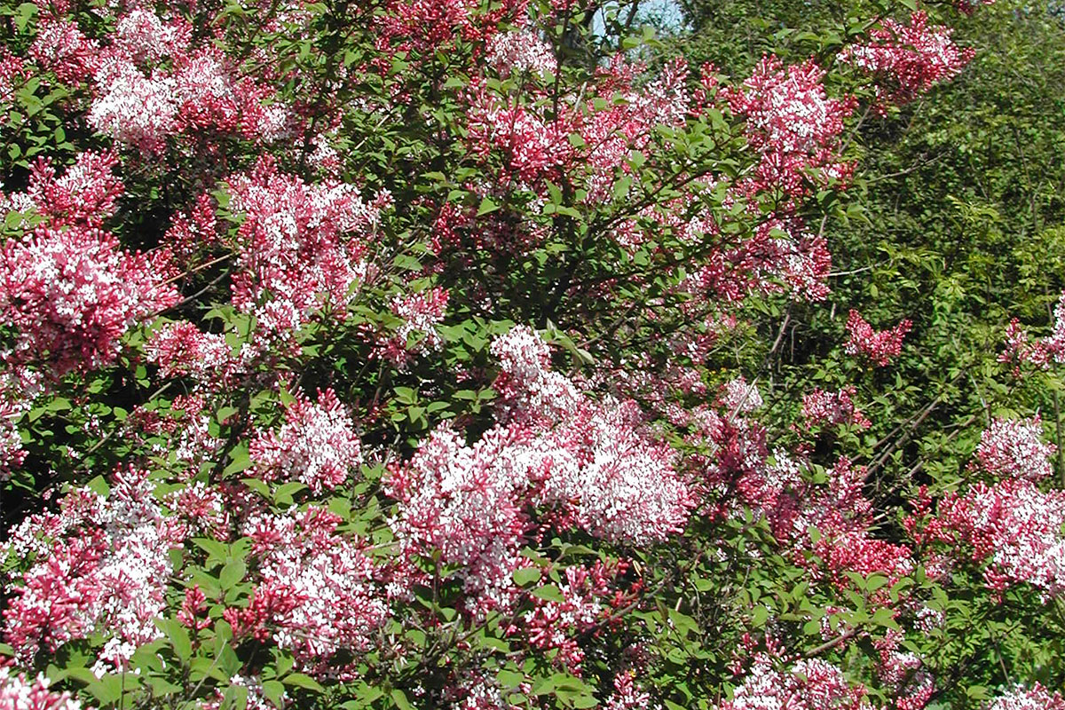
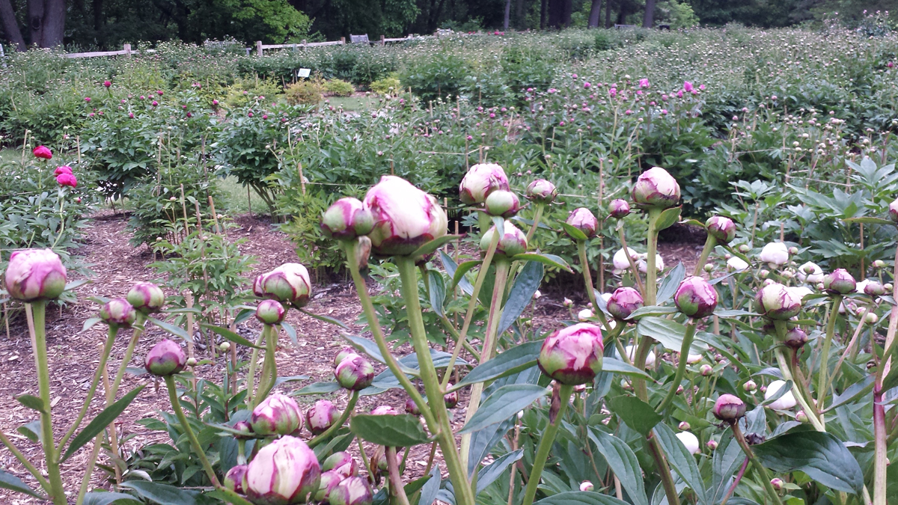
Current work: The Matthaei Botanical Gardens and Nichols Arboretum
A more in-depth case study of a long-lived data collection
1910: Early records stored in a card catalog
1980s card catalogs were first transcribed into TAXIR,
1990s: migrated to BG-Base (a platform specifically designed for botanical gardens)
2003: Microsoft Access in 2003;
2012: most recent version in of access.
2018: ArcGIS “GeoDatabase”
"Historically important shrubs"
Peony garden at Nichols Arboretum, as of June 4

Slide 12
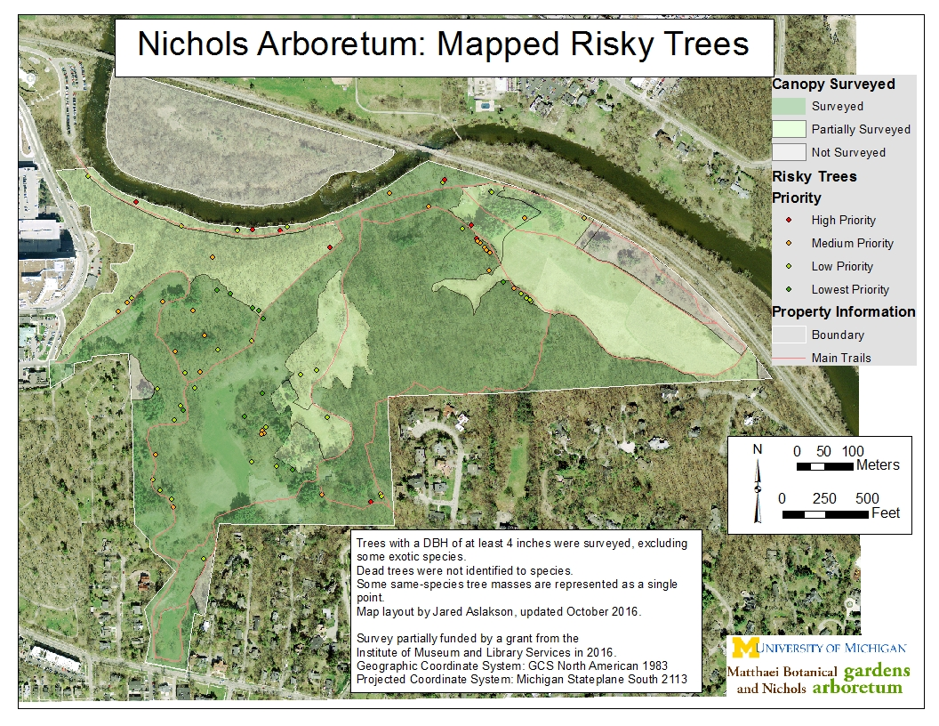
Misc data files, surveys, maps treated “as jewels of individual dragons, in terms of, ‘This is my information, not yours.’”

Slide 13
Practical issues for the MBGNA
Reconstructing legacy data structures & definitions
Prior databases poorly documented
Terms confusingly applied
Database not totally normalized
Many "jewels of individual dragons" still at large
Mapping fields from Microsoft Access to ArcGIS
Different technologies and different ways of thinking about classes, instances, vocabularies
"pick lists" vs. "domains"
Tools exist – but conceptual mapping work still needed

Slide 14
Meta-issues for us as researchers
How to track change over time? How to transform our data into something we can analyze?
Flowcharts/process models – derived from interviews
Graph viz – derived from examination of data structures
EER diagrams – derived from examination of data structures
Sankey diagrams – derived from interviews + data structures

Slide 16
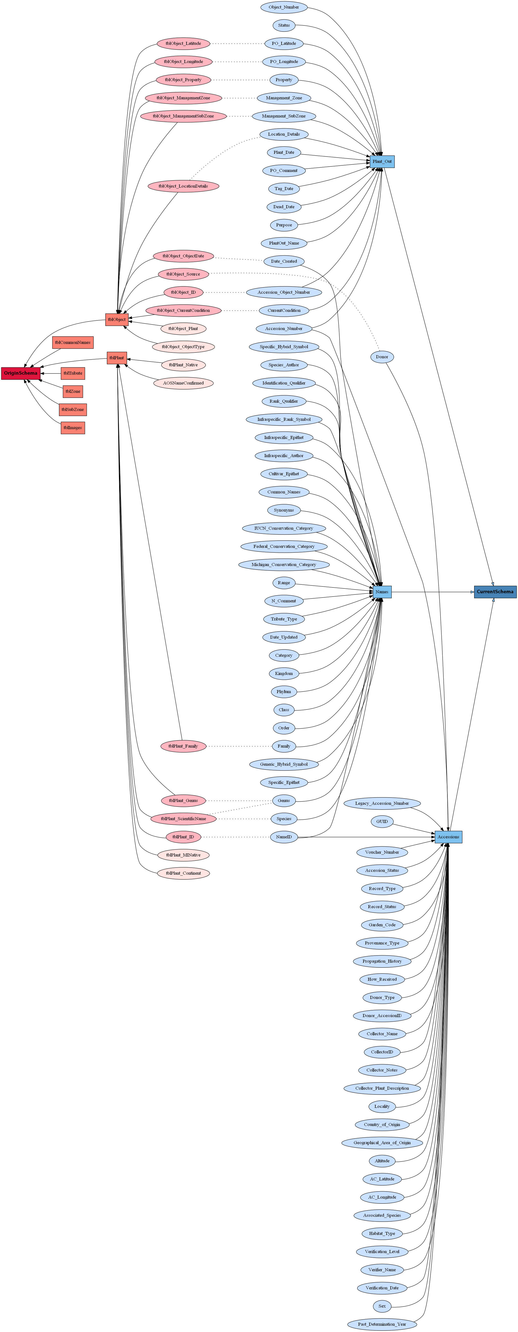
GraphViz

Slide 17
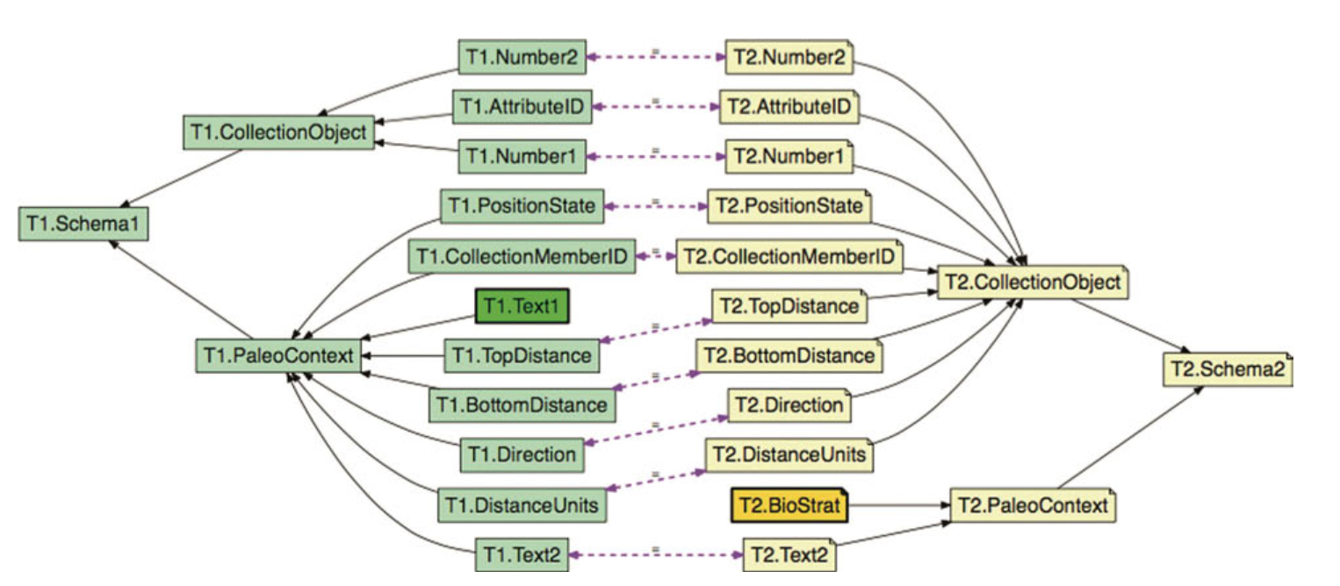
From Thomer et al., 2017

Slide 18
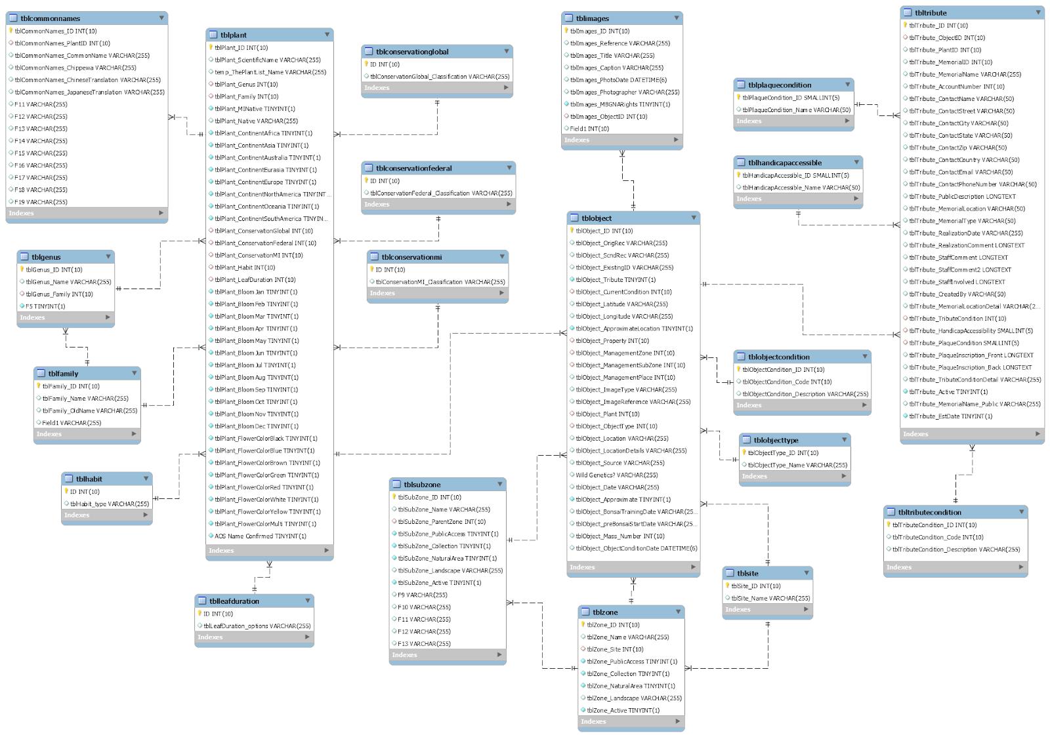

Slide 19
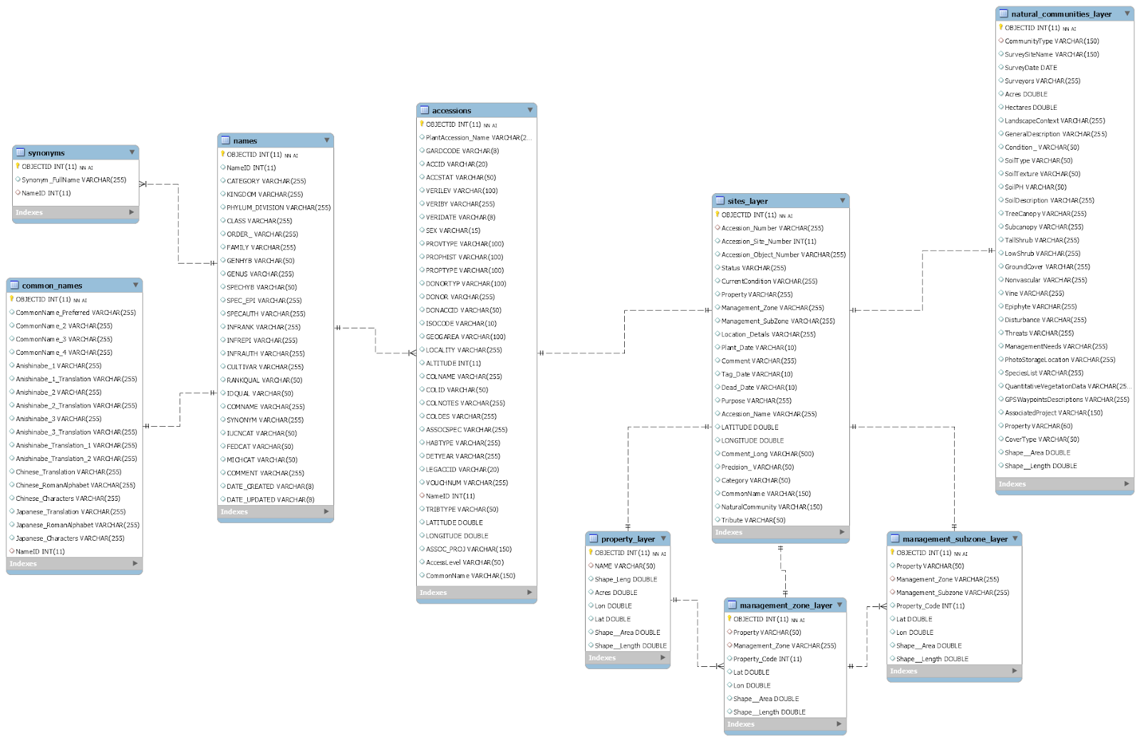

Slide 20
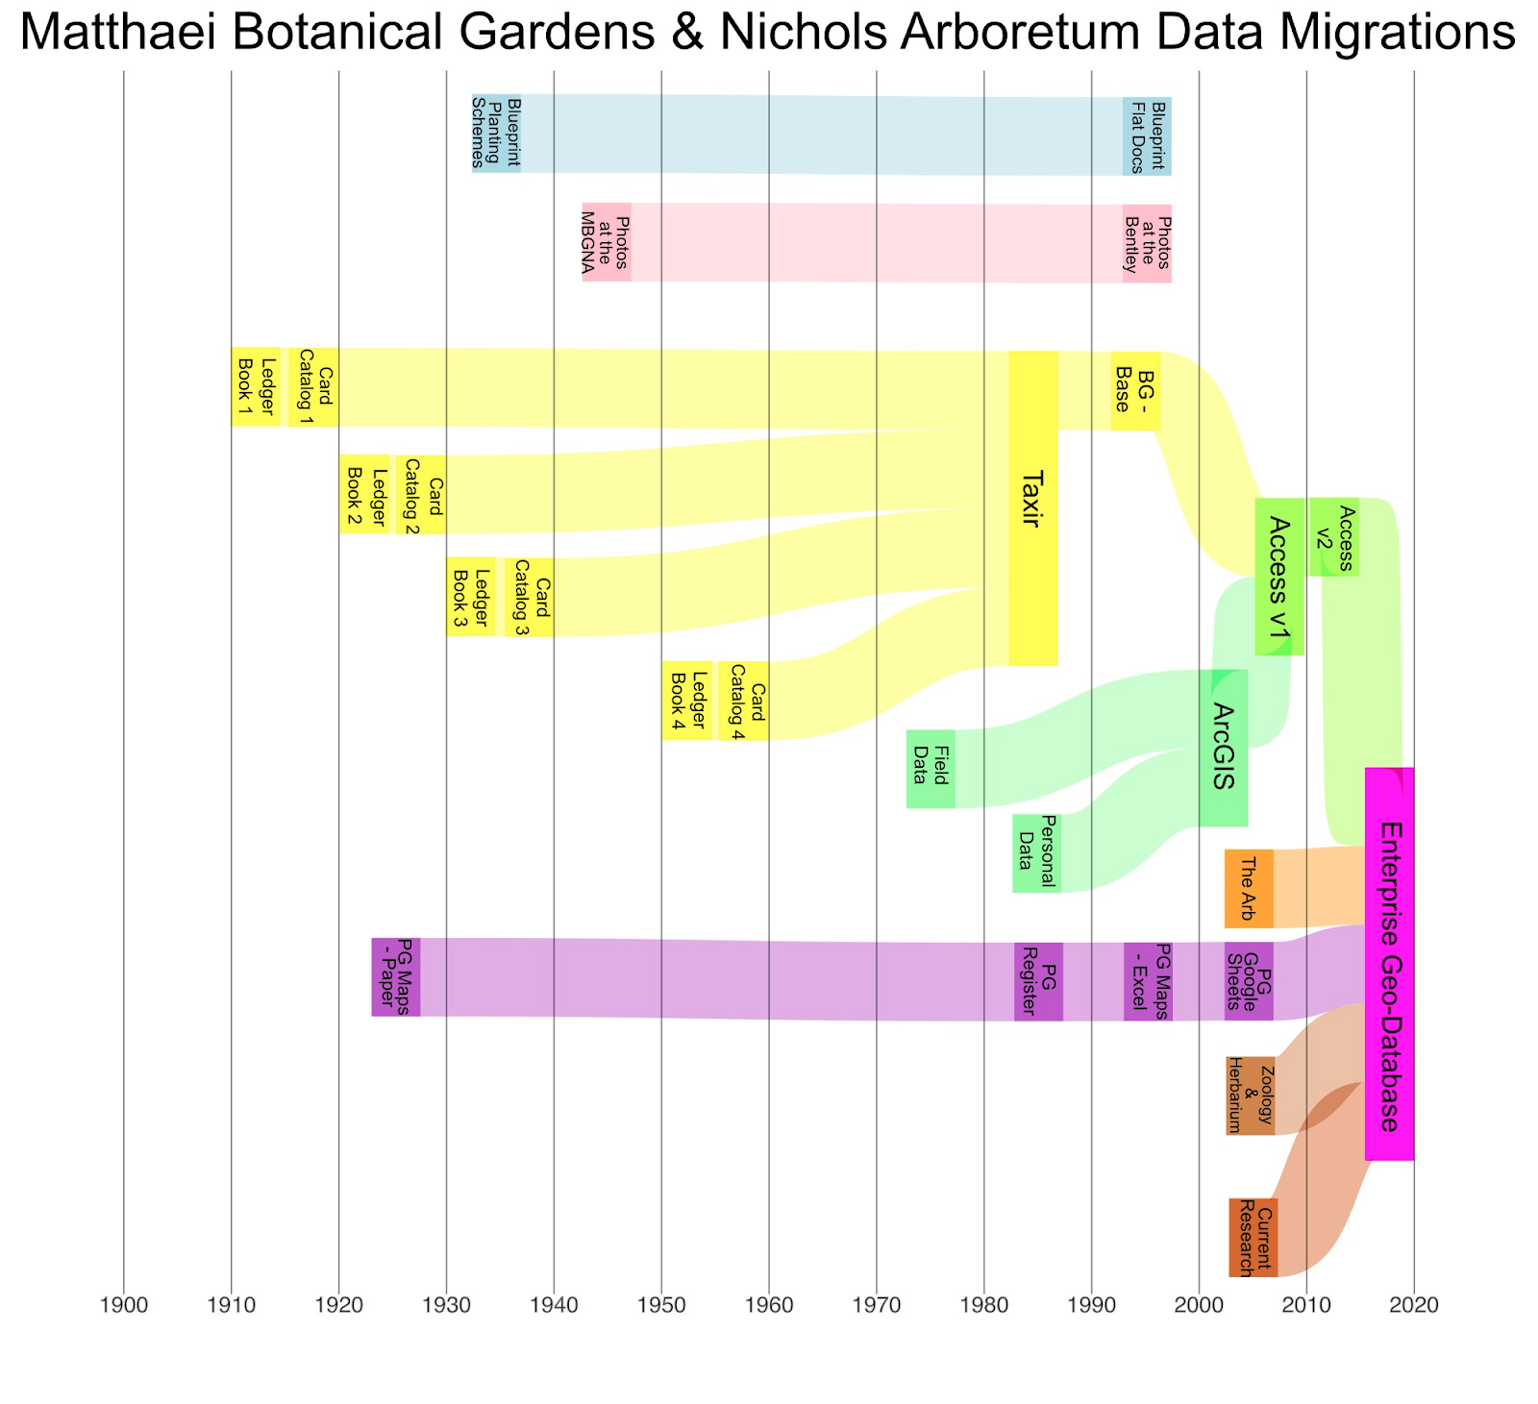
Sankey Diagram

Slide 21
Strengths, weaknesses
Flowchart/Process model: relatively easy to interpret, but lacks field-level granularity
GraphViz: decent field-level granularity, and definitely shows migrations – but unwieldy to visualize
EER: Makes use of existing best practice in field! But requires some expertise to build. Also doesn't show migration particularly well, though supports comparison
Sankey: similar to flowchart, but could be automatable?

Slide 22
Future work, open questions
Refining and workshopping methods of documenting changes
What's important to capture?
Developing best practices for practitioners and researchers alike
Oldest NHM databases are ~50 years old
Databases and past migrations for another 50

Slide 23
Thank you!
Eternal thanks to the NHM collections staff that have shared their time, stories, and insight for this project.
Thanks to my collaborators (particularly Mike Twidale, Kate Topham, Alli Rayburn, Sam Sciolla, Maryse Lundering-Timpano, Daria Orlowska, Clare Michaud, and Nicco Pandolfi) involved in this work.
This project was funded in part by IMLS grant #RE-07-18-0118-18
References:
Star, S. L., & Ruhleder, K. (1996). Steps Toward an Ecology of Infrastructure: Design and Access for Large Information Spaces. Information Systems Research, 7(1), 111–134. https://doi.org/10.1287/isre.7.1.111
Thomer, A., Cheng, Y.-Y., Schneider, J., Twidale, M., & Ludäscher, B. (2017). Logic-Based Schema Alignment for Natural History Museum Databases. Knowledge Organization, 44, 545–558. https://doi.org/10.5771/0943-7444-2017-7-545
Thomer, A. K., Weber, N. M., & Twidale, M. B. (2018). Supporting the long-term curation and migration of natural history museum collections databases. Proceedings of the Association for Information Science and Technology, 55(1), 504–513. https://doi.org/10.1002/pra2.2018.14505501055

Slide 24
4 Emergent trends In maintenance, migration and adaptation

Slide 25
Migration work never ends
If you're not in the middle of one, you're likely planning for one.
And if it's not digital, it's physical
Even with move towards platforms like Arctos, Specify, Axiell, Collective Access, etc, there's a need for on-going maintenance
Data cleaning, sharing, integration, aggregation
Updates and upgrades
Information professionals know this – administrators sometimes do not.

Slide 26
Silo-ization and De-Silo-ization
Cycles of intentionally creating a data silo (a separate data store) away from the "official" database – and then eventually bringing it back together
And/Or
Cycles in which departments/divisions/collections are merged and split by according to varying administrative whims

Slide 27
Databases with “perverse capabilities"
A database supports that short-term goals well enough that people keep using it, but is detrimental to long-term collection or data infrastructure health. Examples:
Co-opting fields: using a data entry field for something other than what it was intended
Databases that print but don't store data for labels (eek!)
Catalog Number | Species | Collector | Notes
AB7848 | Smilodon fatalis | Andie
Catalog Number | Species | Collector | Notes
AB7848 | Smilodon fatalis | Pit 91 | Randcholabrean
But where do I put locality data?
That looks fine!

Slide 28
Rogue, auxiliary, and other-than-official databases
Creation of rogue auxiliary databases in addition to “main” database: things that support data work in a less-than-official way. Examples:
Spreadsheets of data that don't "fit" in the main system (radiocarbon dates, trait data, photo logs)
Google Sheets to support collaborative data entry and curation
Creative uses of R and other programming languages to bring legacy data systems together
Sometimes IT staff hate these – but they play an important function
Danger is in keeping them from developing "perverse capabilities"

Slide 29
So what do we do?

Slide 30
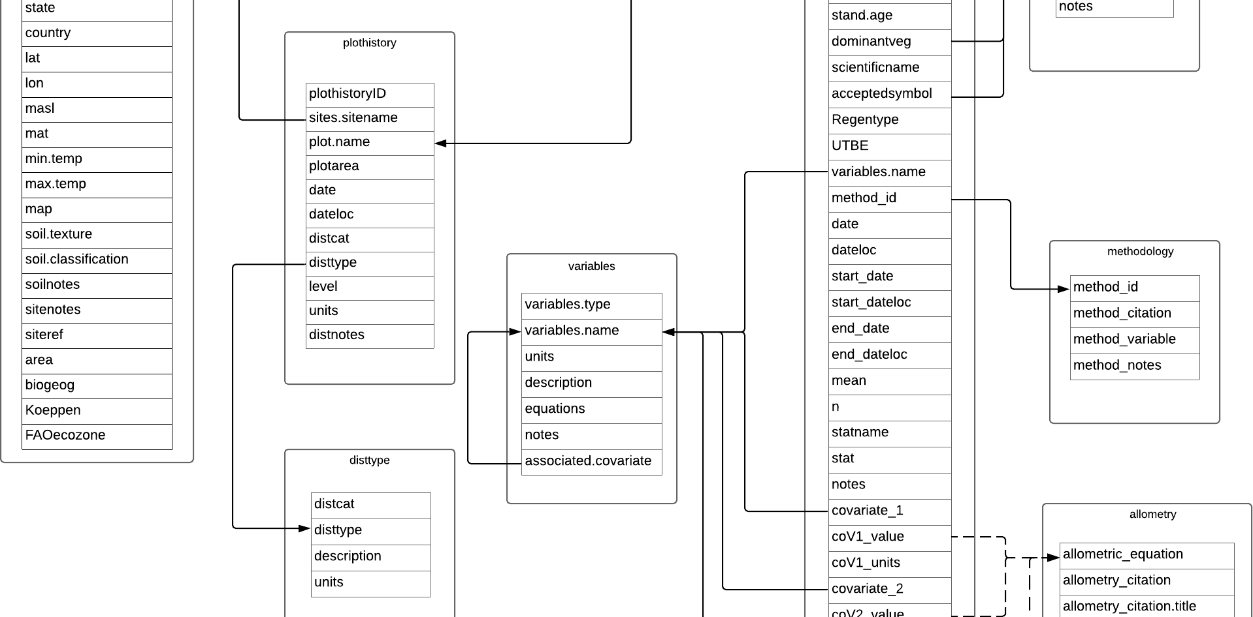
1) Document your migrations!
Oldest NHM databases are ~50 years old
Document your databases and past migrations for another 50
Even if you're happily migrated to Arctos, Specify, etc!
Also document your auxiliary databases
Options:
READMEs and data dictionaries
EER/UML diagrams
Sankey diagrams
Graph visualizations

Slide 31
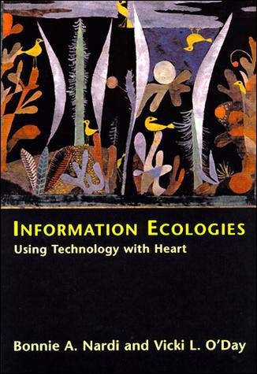
2) Plan for an information ecology
You need to sustain a diverse information ecology – not One Database To Rule Them All
"Rogue" and "auxiliary" databases are inevitable and necessary and important sites of work, and innovation.
Important to work with administrators and IT staff to maintain these, if possible.

Slide 32
3) PLan for Database Curation
Rates of change/durability:
Reports and queries (days – months)
Record updates (months)
Software (months- years)
Hardware (decades at best)
Schema (decades)
The collection (decades? centuries?)
Different aspect of data collections need attention, curation at different tempos and times
After Brand, 1995

Slide 33
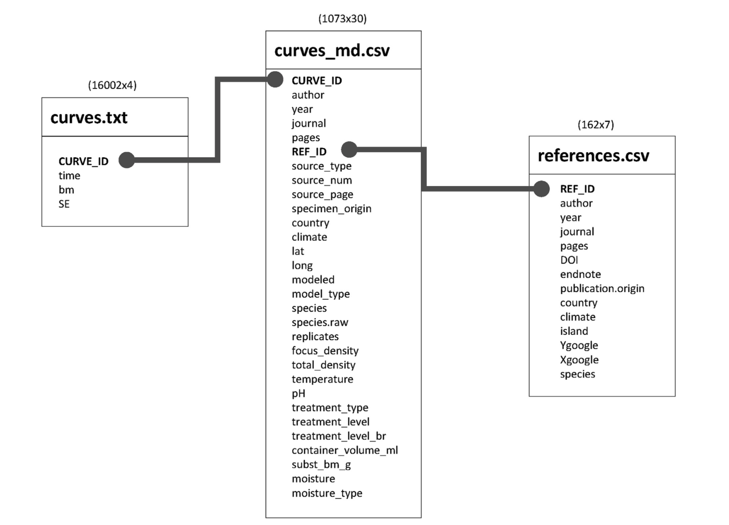
Future work
How best to support
Non-database databases
Information modeling and "relational thinking"
Reliance on a distributed range of data systems – despite persistent dreams of centrality
Moving on to other LAMs
Notes:
Ok – back to this framing around natural history and data histories

